Slide 1

Implementing team-based learning in an online synchronous environment for a career skills workshop
Brian O’Dwyer
Embry-Riddle Aeronautical University Asia (Singapore Campus), Adjunct Faculty
CognaLearn, Executive Chairman and Commercial Founder
Duke-National University of Singapore Medical, Former Entrepreneur-in-Residence
eLearning Forum Asia 2018
National Taipei University of Business
Taipei, Taiwan
24 May 2018

Slide 2
Acknowledgements
The author would like to acknowledge the contribution of: the students and staff of the Career Management Center of Duke University's Fuqua School of Business in participating and organizing the online career skills workshops and Eden Heng in assisting with collecting, analyzing and presenting this information.
The Author is the Commercial Founder of and has a financial interest in CognaLearn. CognaLearn is the company that developed InteDashBoard™ www.intedashboard.com, which is TBL software developed in collaboration with Duke-US Medical School; InteDashBoard™ is one of the technology tools described in this presentation.
A poster version of this presentation was presented at the 2018 Team-Based Learning Collaborative Conference 2018, San Diego, United States

Slide 3
Objectives
After this session participants should be able to:
Explain: who I am and why I am here
Describe: how team-based learning (“TBL”) was implemented online
Identify: what we learned about online TBL

Slide 4
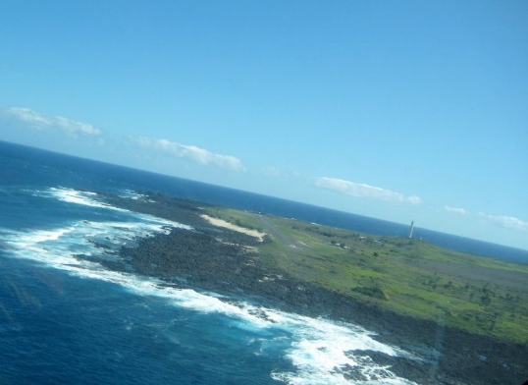
Landing objective

Slide 5
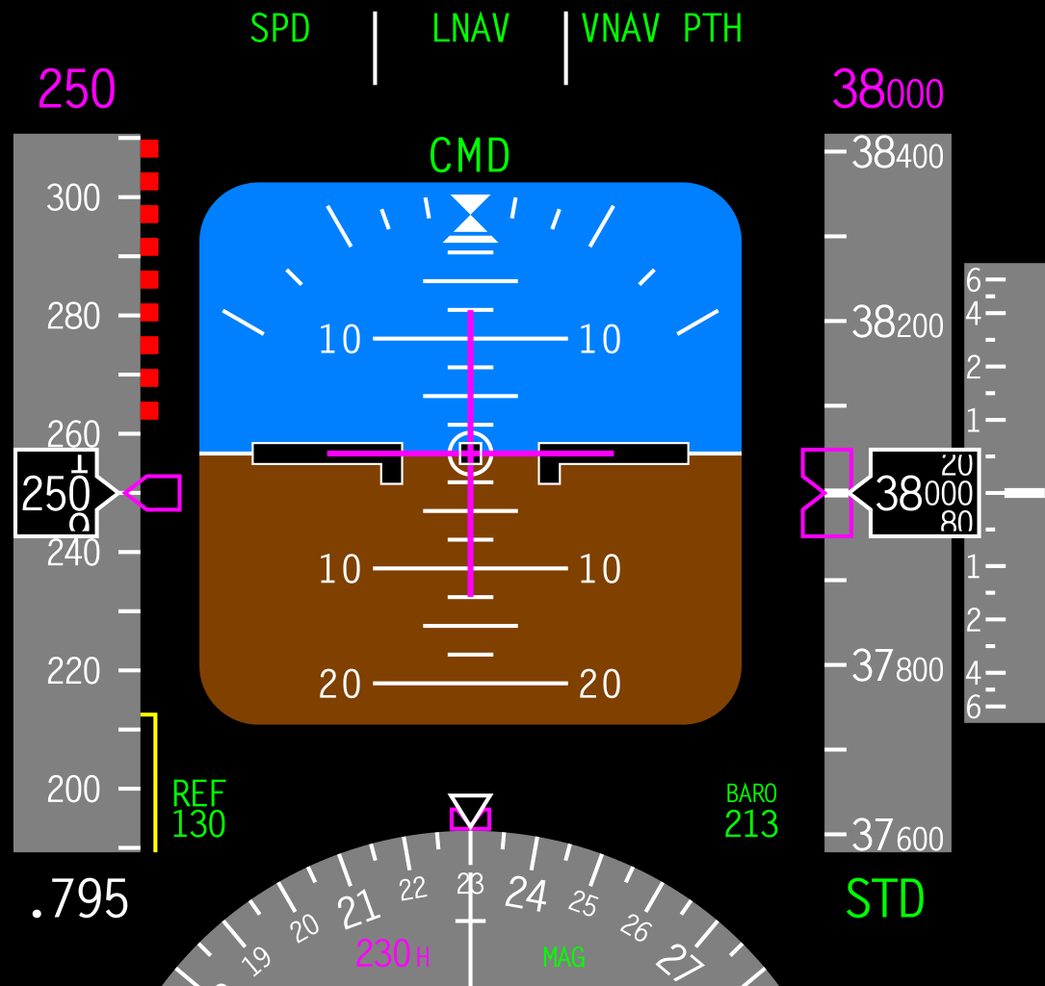
Too fast? Too slow?
Too high? Too low?

Slide 6



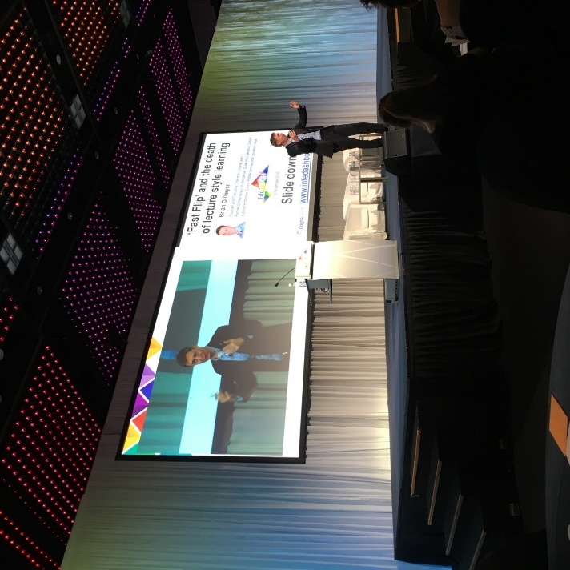
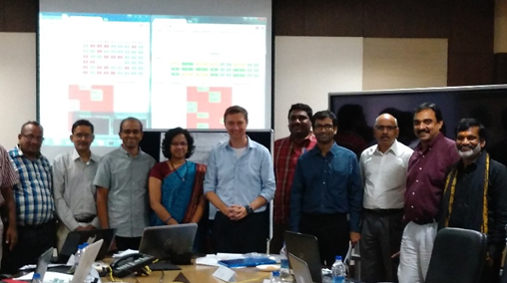
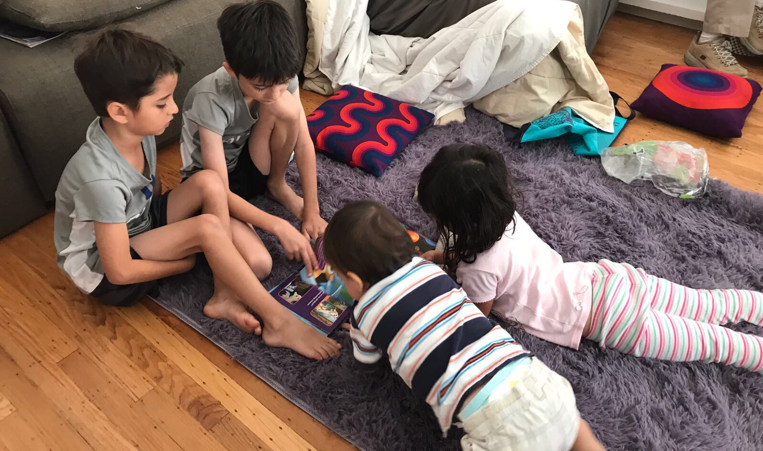
Team-based learning…
Educator
Entrepreneur
Speaker
Parent
Copyright Brian O’Dwyer and CognaLearn Pte Ltd and www.intedashboard.com where applicable.
Slides available from odwyerb@erau.edu and may be used with attribution

Slide 7



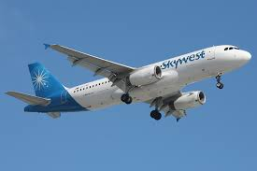



My path

Slide 8
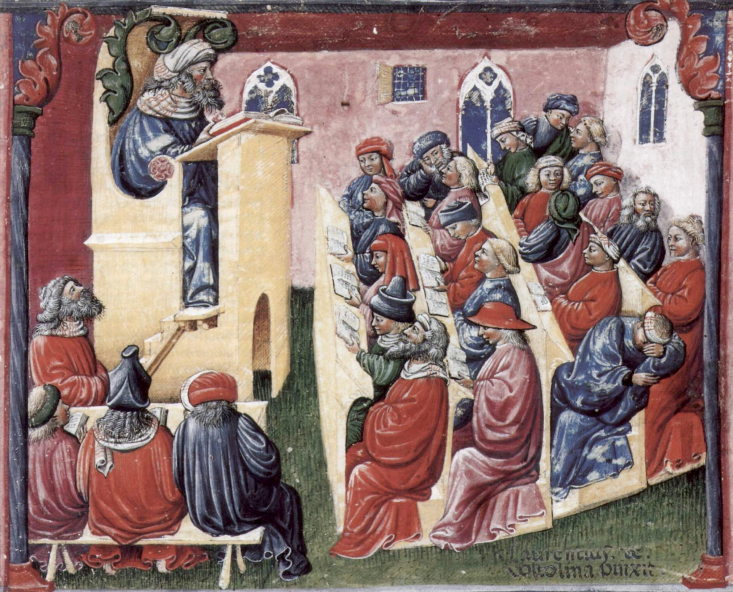
Problem 1: Hard to teach career skills with traditional lectures
Learning 1.0
Career strategy
Pitching
Resume writing
Networking
Interviewing
=
Laurentius de Voltolina, School of
Bologna 14th century.

Slide 9
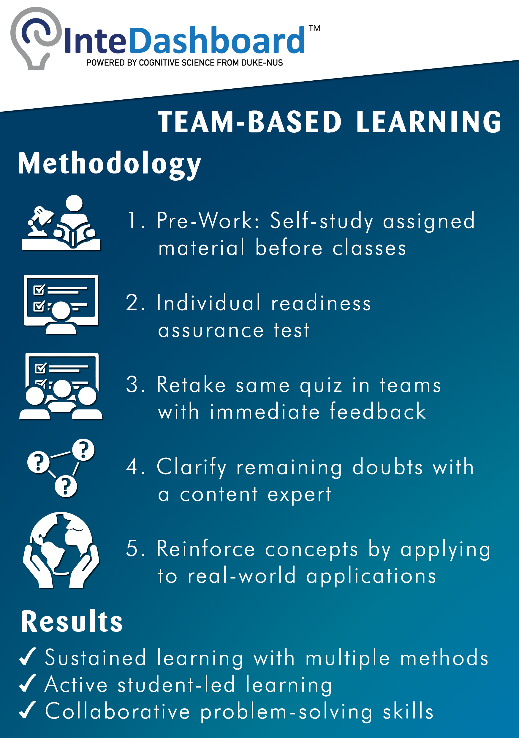
Solution 1: Team-based learning (“TBL”)
Theory
Application
1. Pre-work
2. Quiz
3. Team quiz
4. Clarify
doubts
5. Team applications

Slide 10
Problem 2: Hard to teach career skills to one year masters students before recruiting
Recruiting for jobs
Graduate
Enroll
July
September
May

Slide 11
Solution 2: teach career skills with online TBL before they arrive
Career skills workshop with online TBL
Recruiting for jobs
Graduate
Enroll
July
September
May

Slide 12
Online TBL career skills workshop
Objectives
1. Explain what pitching is and why it matters
2. Describe the five steps of pitching
3. Draft and execute your own: positioning matrix, 15-second pitch, five-bullet pitch, 90-second pitch and cover letter
Presentation: PowerPoint presentation (60 slides); ~30 minutes
Individual Readiness Assurance Test (“IRAT”): 10 multiple choice questions (“MCQs”) answered individually; ~10 minutes
Team Readiness Assurance Test (“TRAT”): same 10 MCQs answered as a team with immediate feedback using www.intedashboard.com; ~10 minutes
Clarification: discuss difficult IRAT and TRAT questions: ~10 minutes
Applications: ~60 minutes
1. Rank order the top three skills required for consulting. (free response)
2. Which of the following is the best story to use if you are interested in consulting? (MCQ)
3. Take the story your selected in question two and outline it using the STARI framework (Situation, Task, Action, Result, Implication)

Slide 13
Online career skills workshop agenda
Objectives
1. Explain what pitching is and why it matters
2. Describe the five steps of pitching
3. Draft and execute your own: positioning matrix, 15-second pitch, five-bullet pitch, 90-second pitch and cover letter
Presentation: PowerPoint presentation (60 slides); ~30 minutes
Individual Readiness Assurance Test (“IRAT”): 10 multiple choice questions (“MCQs”) answered individually; ~10 minutes
Team Readiness Assurance Test (“TRAT”): same 10 MCQs answered as a team with immediate feedback using www.intedashboard.com; ~10 minutes
Clarification: discuss difficult IRAT and TRAT questions: ~10 minutes
Applications: ~60 minutes
1. Rank order the top three skills required for consulting. (free response)
2. Which of the following is the best story to use if you are interested in consulting? (MCQ)
3. Take the story your selected in question two and outline it using the STARI framework (Situation, Task, Action, Result, Implication)

Slide 14
Method
The workshop was conducted using the www.zoom.us web video and audio conferencing tool which allowed “breakouts” for team activities. Teams were broken out into separate web conference rooms during the TRAT and application exercises.
Pre-work: The session began with an overview presentation of the content.
Readiness assurance: After the presentation, an IRAT and TRAT were conducted. Learners took the IRAT and TRAT using www.intedashboard.com. There was a clarification session after the TRAT.
Application Exercises: After the IRAT and TRAT, teams worked on MCQ and free response application exercises using www.intedashboard.com. There was a discussion session after the applications.
Survey: Several days after the session, a participant feedback survey was distributed to participants using https://www.qualtrics.com/.

Slide 15
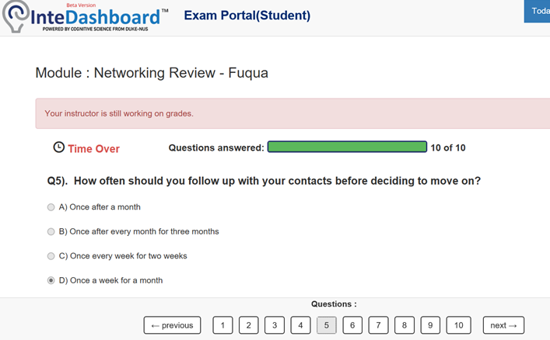
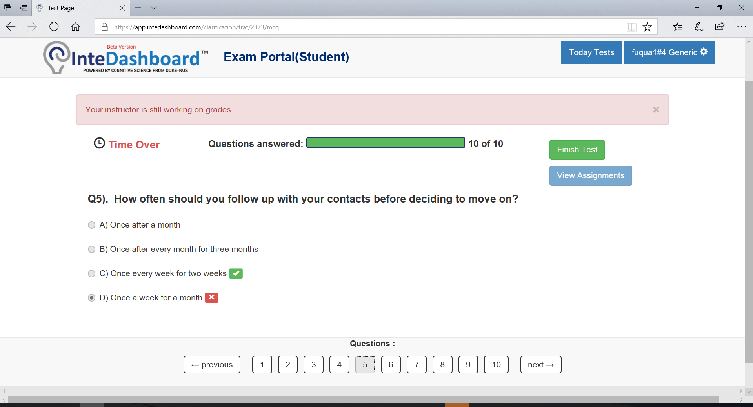
Individual readiness assurance test and team readiness assurance test
IRAT (Student View)
TRAT (Student View)

Slide 16
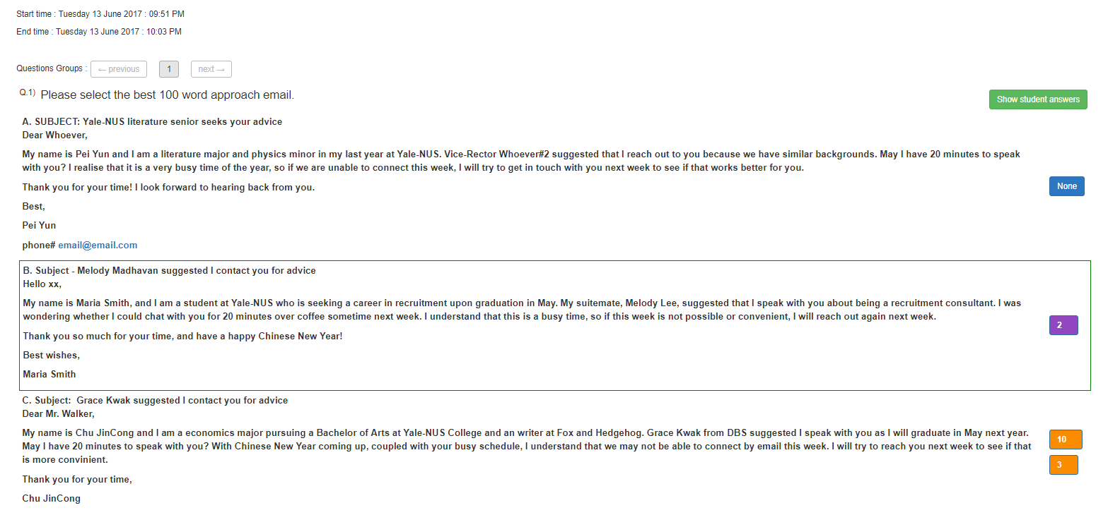
Applications – multiple choice

Slide 17
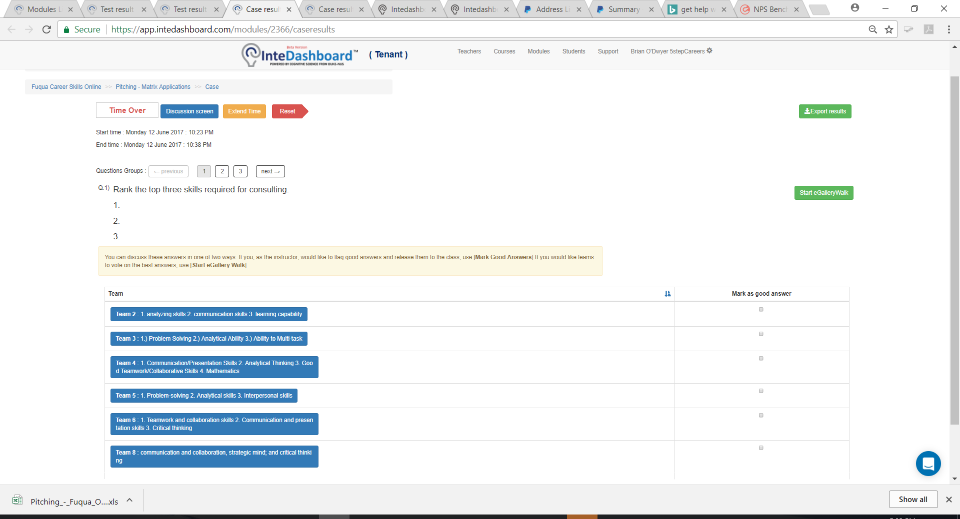
Applications – free response

Slide 18
Results – overall recommendation
Response to: “Would your recommend to others: 1 Strongly disagree, 2 Disagree, 3 Neither agree or disagree, 4 Agree and 5 Strongly agree?”

Slide 19
Results – IRAT and TRAT scores
IRAT
TRAT
IRAT
TRAT

Slide 20
Results – completion time
First session online
Second session online
Face-to-face

Slide 21
Caveats
Very small sample size
  20 participants
  13 completed survey
Starting point for future investigation only
Early stage of analysis

Slide 22
Summary
Team-based learning (“TBL”): can be done in an online synchronous modality
TBL data examples suggest:
F2F > online TBL > online alone
Team effect in online
Learners adapt to online modality
Learn more
Brian O’Dwyer
odwyerb@erau.edu
Team-Based Learning Collaborative
www.teambasedlearning.org
TBL software
www.intedashboard.com

